Slide 1
EXPLORATORY DATA ANALYSIS USING TABLEAU
UNVEILING AUTOMOBILE SALES TRENDS PROJECT PART-1
MENTOR: MUNNA PANDEY
SUBMITTED BY :
M.PRIYANKA

Slide 2
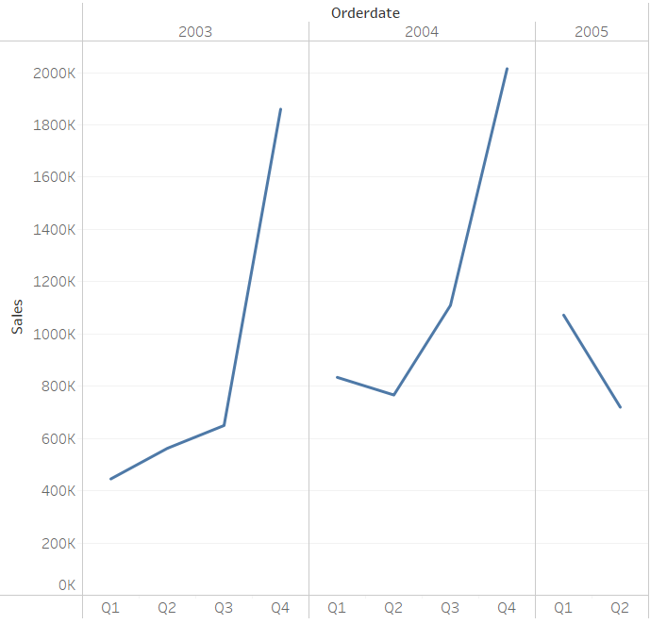
A DATA-DRIVEN APPROACH TO MARKETING STRATEGY PROJECT PART-1
SALES ANALYSIS:
What is the total trend in total sales amount over different quarters and years?
INTERPRETATION: From this identified that in 2003 and 2004 the sales are increasing over the quarters.

Slide 3
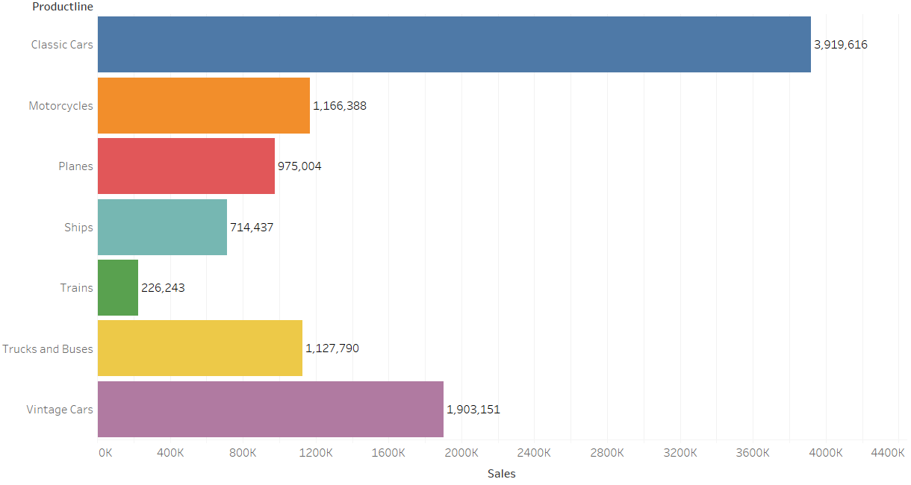
How do different product line contribute to the total sales.
INTERPRETATION: From this identified the product lines wise total sales. The classic cars has highest sales compared to other product line

Slide 4
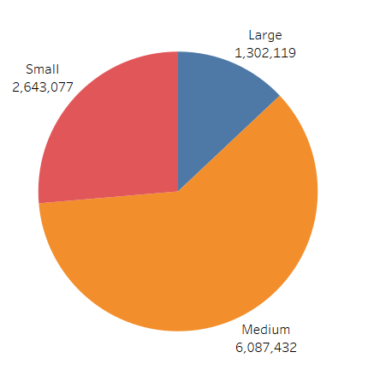
What is the impact of different deal sizes on total sales.
INTERPRETATION: From this identified that the more sales on medium deal size.

Slide 5
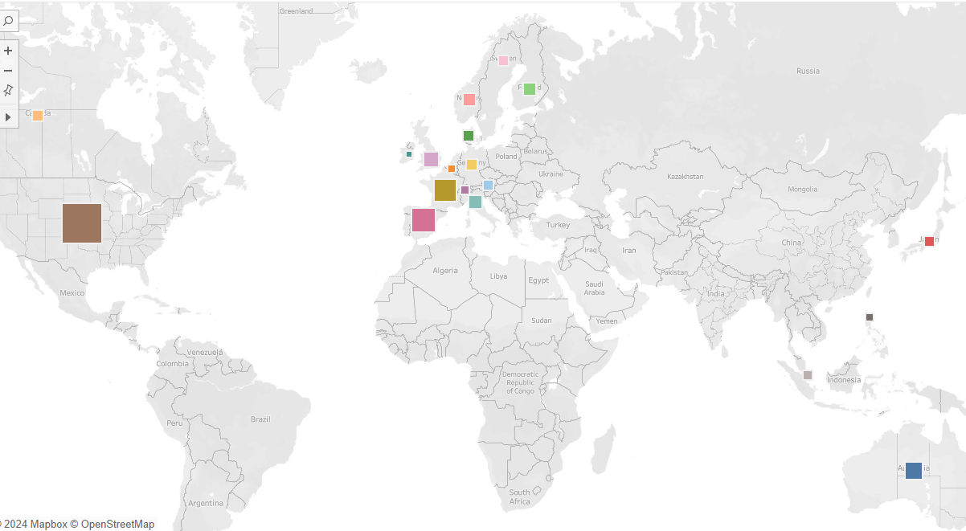
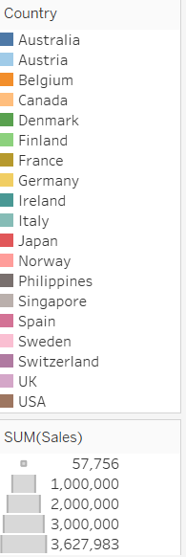
CUSTOMER SEGMENTATION
How are sales are distributed across different countries and territories
INTERPRETATION: From that the sales are distributed across different countries .The France has highest sales distribution

Slide 6
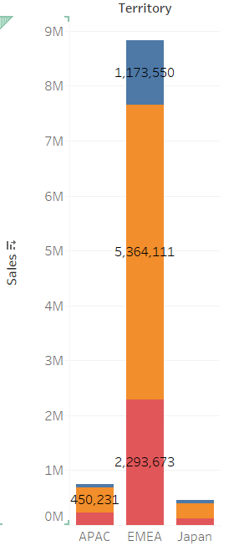
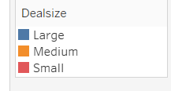
How does size of deal vary across different territories.
INTERPRETATION: From this the EMEA territory has most vary deal sizes and in EMEA has most vary between medium size and large and small.

Slide 7
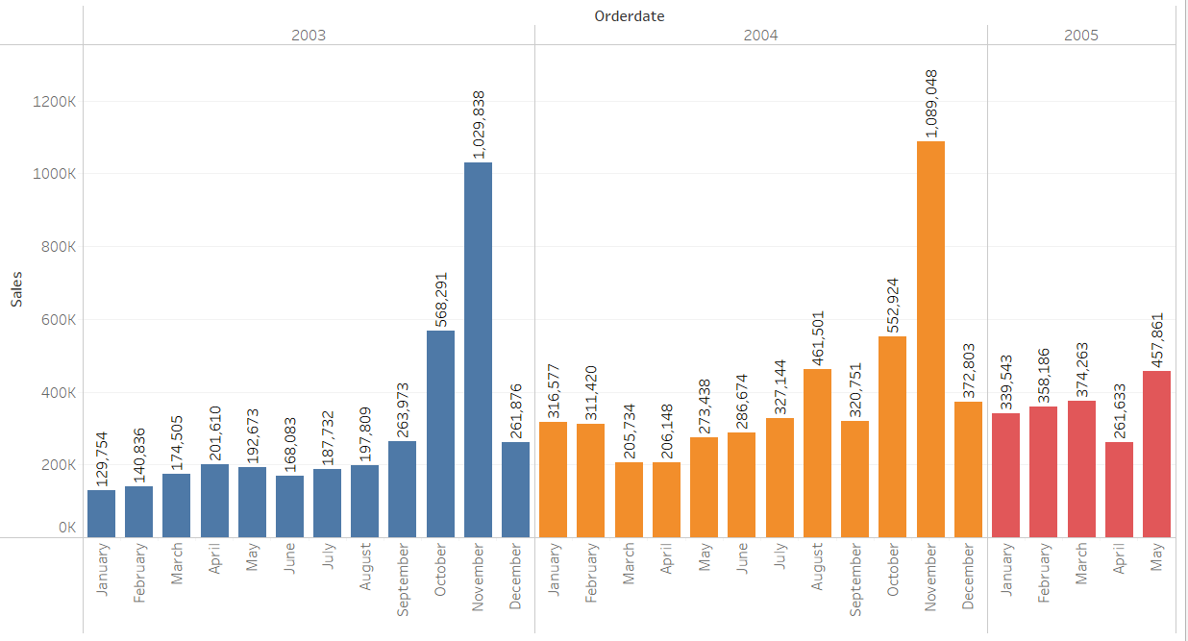
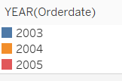
SALES FORECASTING
How sales evolved over different years and months.
INTERPRETATION: From that evolved the sales over months and years .In the year 2004 in November has highest sales.

Slide 8
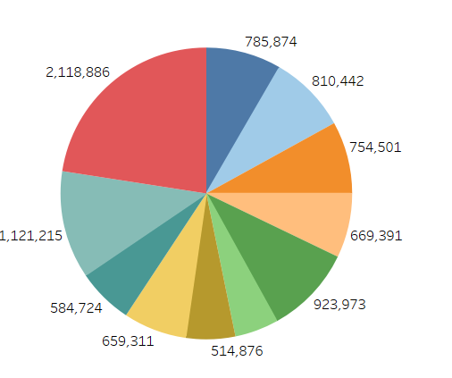
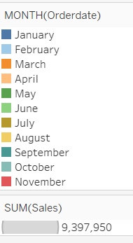
Can you identify any patterns or seasonality in sales data.
INTERPRETATION: From this in the Month of November has most seasonality sales.

Slide 9
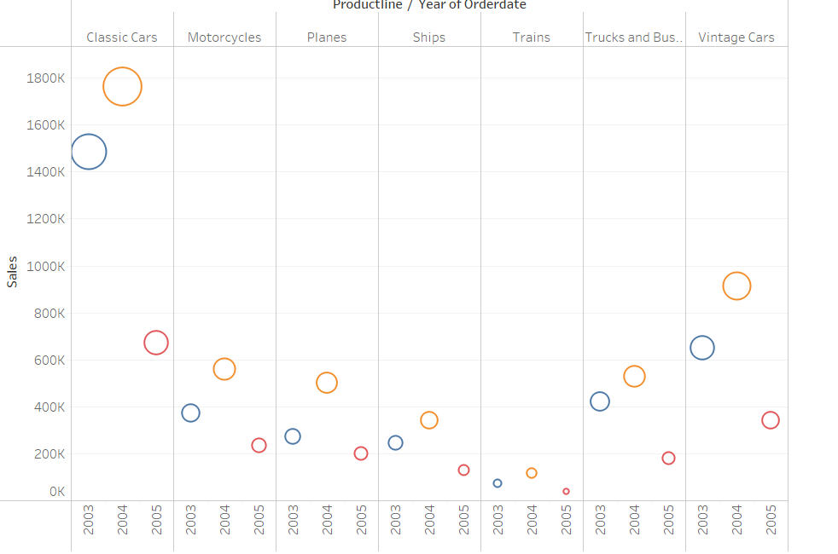
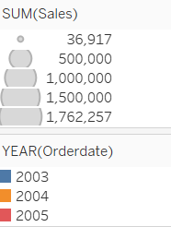
What factors might influence future sales based on historical data.
INTERPRETATION: From that The product line might influence on sales.

Slide 10
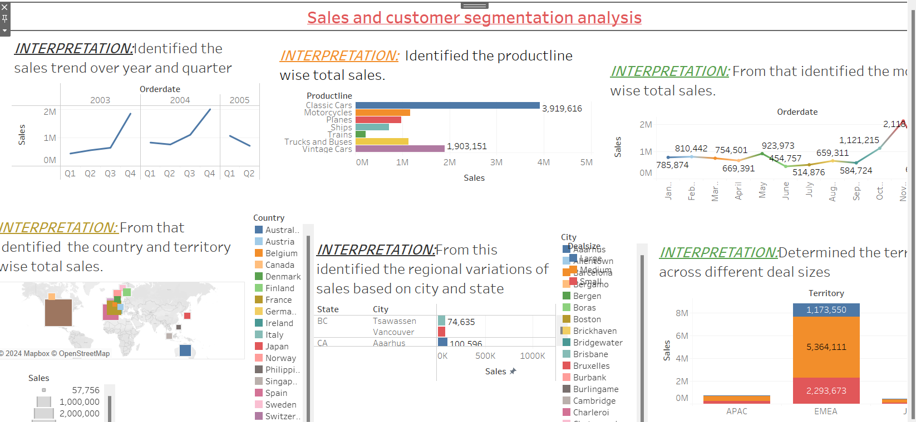
DASHBOARD

Slide 11
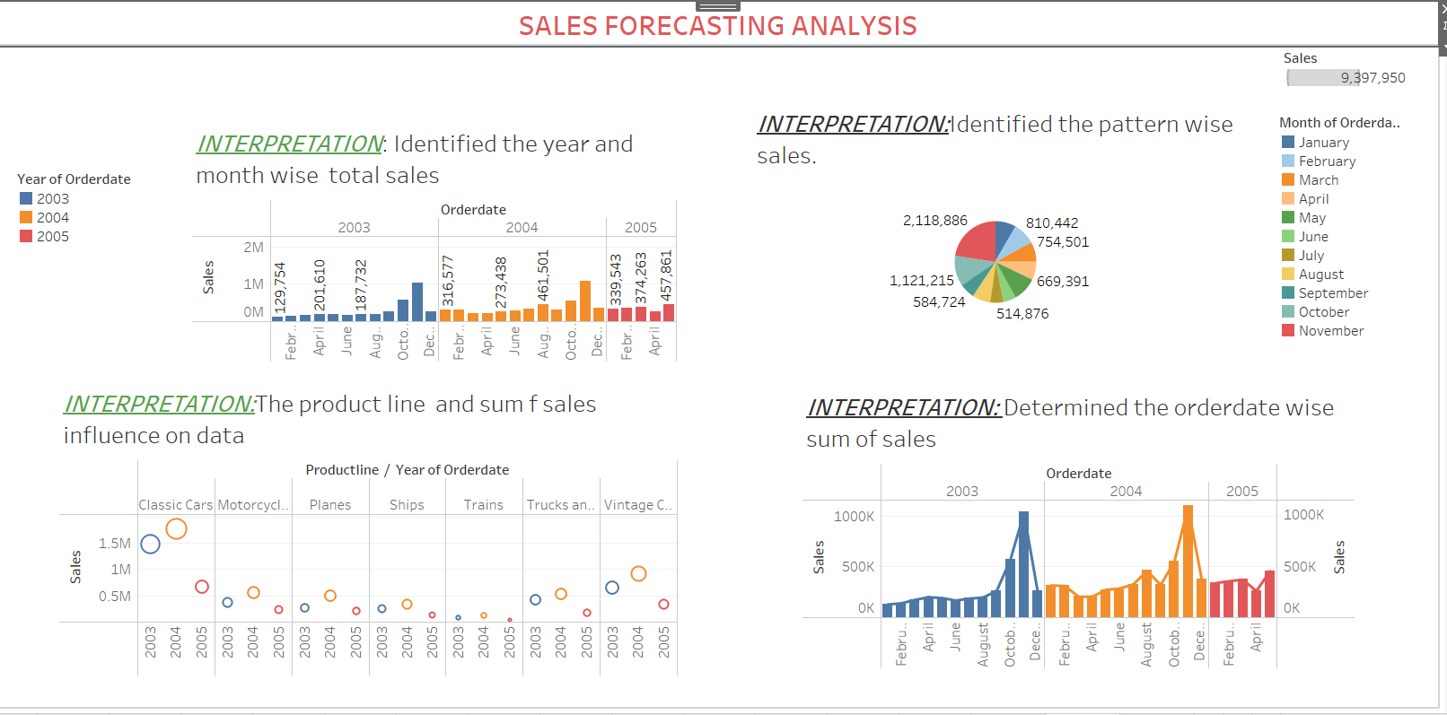
DASHBOARD

Slide 12
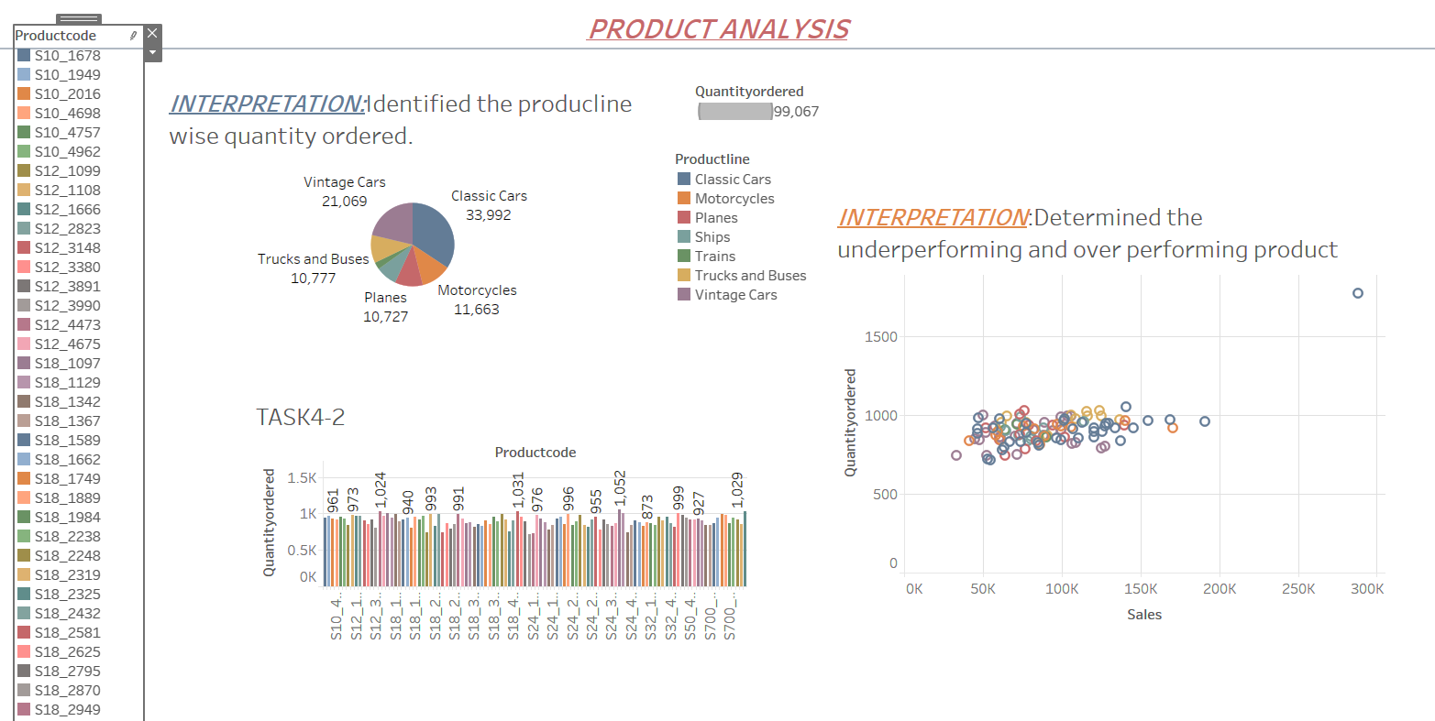
DASHBOARD

Slide 13
UNVEILING AUTOMOBILE SALES TRENDS PROJECT PART-2

Slide 14
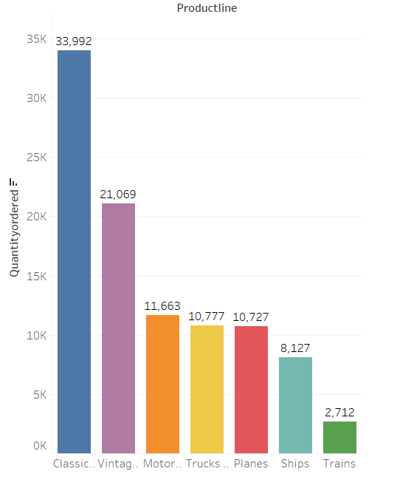
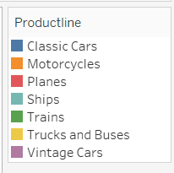
INVENTORY MANAGEMENT
Which product have highest and lowest quantities ordered.
INTERPRETATION: From that the classic cars have highest quantities ordered and trains has lowest quantities ordered.

Slide 15
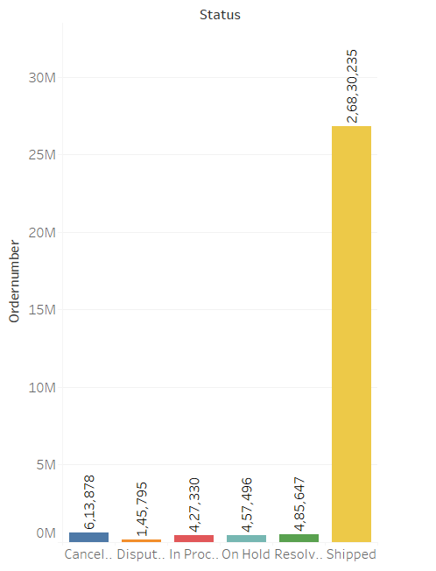
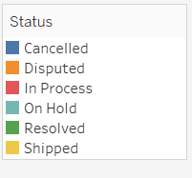
ORDER FULFILLMENT ANALYSIS
What is the distribution of order status.
INTERPRETATION: From this identified the distribution of order status.

Slide 16
CONCLUSION:
From part 1 Sales analysis identified the sales trend over on years 2003 and 2004.And also product lines wise total sales and classic cars has highest sales compared to other product line. And also identified that the more sales on medium deal size.
From customer segmentation the sales are distributed across different countries and France has highest sales distribution. And also EMEA territory has most vary deal sizes.
From part 2 Inventory management classic cars have highest quantities ordered and trains has lowest quantities ordered.\

